Slide 1
Ideation Phase Brainstorm & Idea Prioritization Template
Date | 25 jun2025
TeamID | LTVIP2025TMID40335
Project title | Taffictelligence:Advanced traffic volume estimation with machine learning
Maximum marks | 4

Slide 2
Brainstorm & Idea Prioritization Template: Brainstorming provides a free and open environment that encourages everyone within a team to participate in the creative thinking process that leads to problem solving. Prioritizing volume over value, out-of-the-box ideas are welcome and built upon, and all participants are encouraged to collaborate, helping each other develop a rich amount of creative solutions. Use this template in your own brainstorming sessions so your team can unleash their imagination and start shaping concepts even if you're not sitting in the same room. Reference: https://www.mural.co/templates/brainstorm-and-idea-prioritization

Slide 3
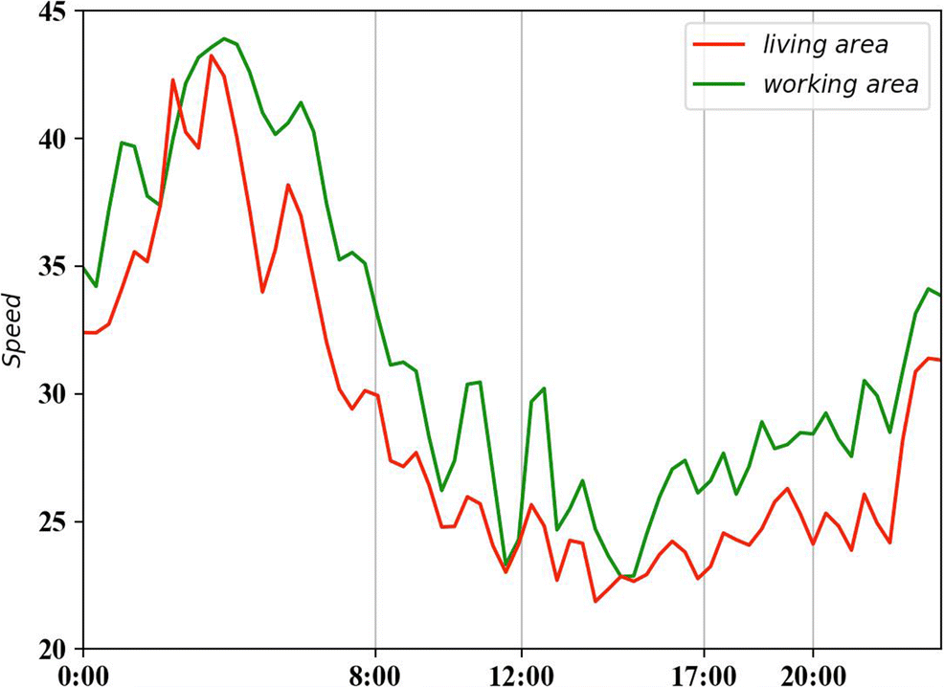
Step-1: Team Gathering, Collaboration and Select the Problem Statement
- *Diverse Expertise*: Transportation planners, data scientists, engineers, and urban planners. - *Collaborative Approach*: Sharing insights, best practices, and innovative solutions. - *Common Goal*: Improving traffic management, reducing congestion, and enhancing road safety. - *Key Activities*: Data analysis, model development, and strategy implementation. - *Outcome*: Smarter, more efficient transportation systems benefiting communities and the environment. This team works together to leverage data and technology for better traffic management.

